Slide 1
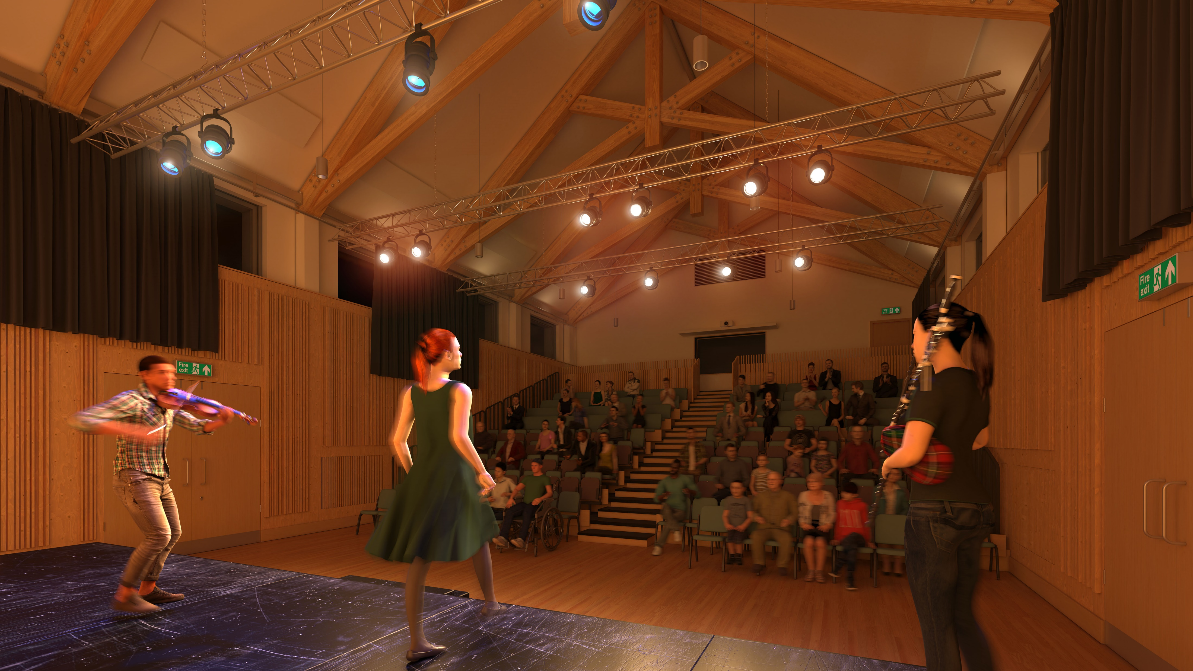




Cnoc Soilleir
Phase 2
Artist’s impression of the new performance space with adjustable seating
A Joint Venture with a Shared Vision

Slide 2
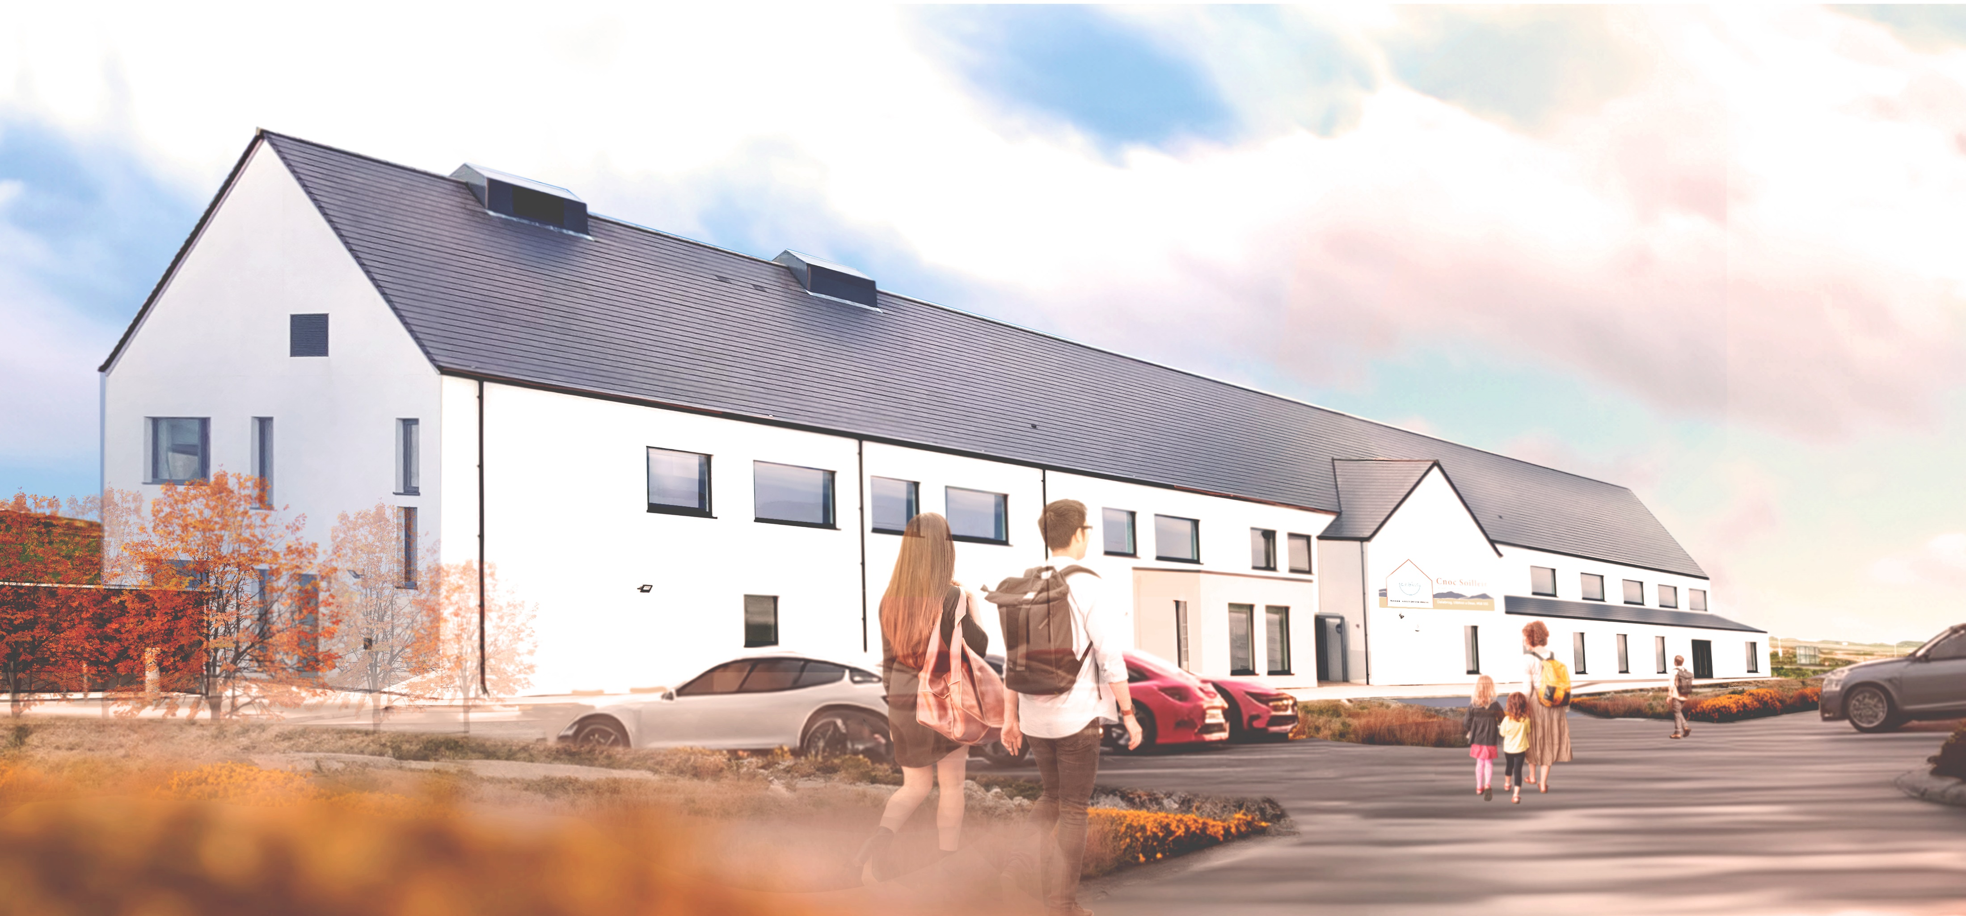
Cnoc Soilleir
Phase 2
Artist’s impression of the whole building
A Joint Venture with a Shared Vision

Slide 3
Cnoc Soilleir
Ambitions and Vision for Phase 2
Ambitions and Vision for Phase 2
A world class facility to enable delivery of high-quality professional performances
A world class facility to showcase Gaelic arts including traditional and contemporary music, dance and performance
A world class facility to capitalise on and strengthen the natural resources within a vibrant natural Gaelic community
A world class facility to inspire and build confidence within the local community
A world class facility to act as a beacon of excellence to engage with a wider audience, and to attract people to Uist
Phase 2
Aspiration - Inspiration - Transformation
A Joint Venture with a Shared Vision

Slide 4
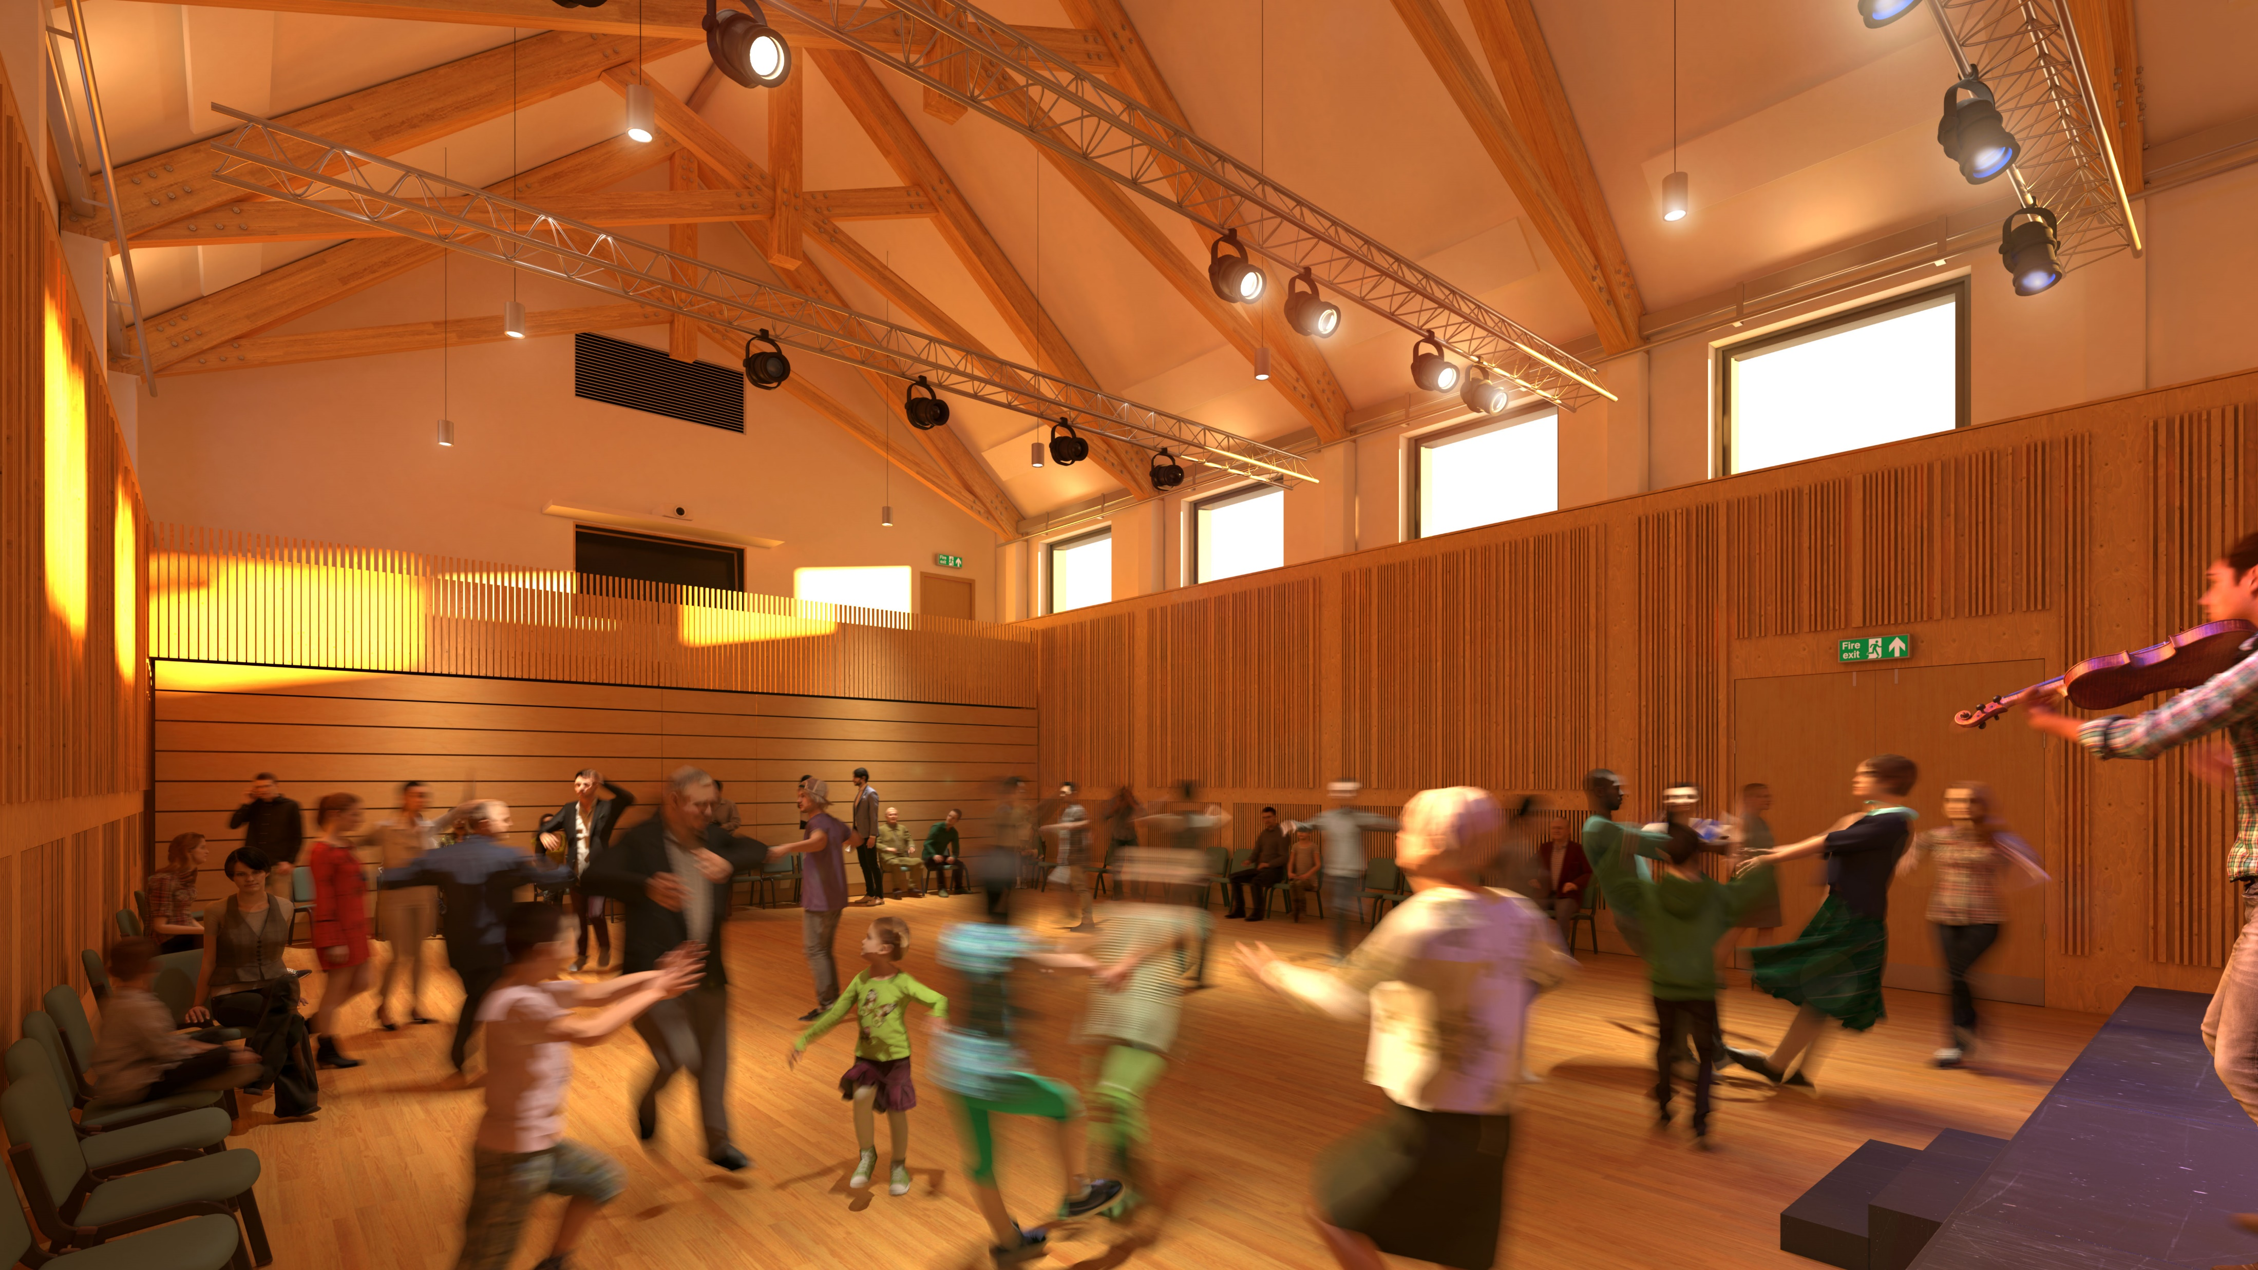
Cnoc Soilleir
Phase 2
Artists’s impression of the new performance space with seating pushed back to create open dance floor
A Joint Venture with a Shared Vision

Slide 5
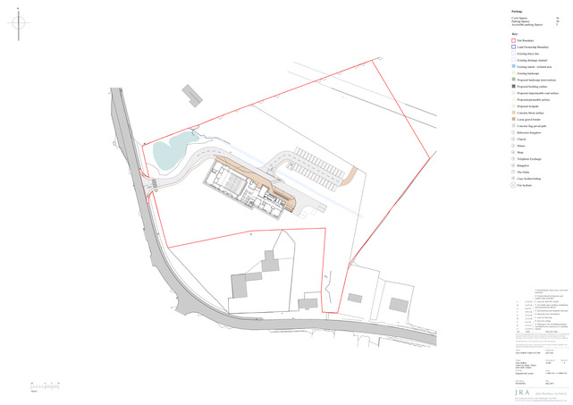
Site Plan
Cnoc Soilleir
Views to hills
To Benbecula
N
PHASE 1
drop off and entrance
PHASE 2
Vehicle and pedestrian access and egress from site
Cnoc Soilleir
car parking
Phase 2
Church and Manse
To Daliburgh
&
Eriskay
Views to Machair and Barra south and west
.
To Lochboisdale
A Joint Venture with a Shared Vision

Slide 6
Cnoc Soilleir
Phase 2 Includes:
Flexible performance hall, with acoustics suitable for music and performance.
The hall will have a sprung floor suitable for dance learning, rehearsing, performances, and ceilidhs
The designs include retractable auditorium seating for audiences of upto 200 people
Breakout space for audience
A small dance studio with sprung floor, and mirrors
Two additional teaching spaces also to double up as green rooms and rehearsal space.
The existing kitchen area in an Lasag will be extended to be able to act as a bar and servery area for performances.
Phase 2
Aspiration - Inspiration - Transformation
A Joint Venture with a Shared Vision

Slide 7
Cnoc Soilleir
Site Plan – Phase 2
Parking
Phase 2
Phase 2
Entrance through phase 1
Phase 1
A Joint Venture with a Shared Vision

Slide 8
Ground Floor Plan – Phase 2
Cnoc Soilleir
Fire Escape
Phase 1
Access for stage and equipment
Teaching room
green room
31m²
Foyer / breakout space
An Lasag
130m²
Public Access
store
Flexible Performance Hall
200 m²
Storage for retractable seating
stage access
Audience access
WC & Shower
Phase 2
store
Dance Studio Green room
45m²
stage access
Audience access
Foyer /breakout space
Public Access
Peat Stove
Fire Escape
A Joint Venture with a Shared Vision

Slide 9
First Floor Plan – Phase 2
Cnoc Soilleir
Phase 1
Live recording desk on Mezzanine level
Roof below
Studio and sound booths
Flexible Performance Hall
double height space
with
200 Seat Retractable Seating
200 m²
Mezzanine balcony over seat storage
Control Room with link to auditorium
Phase 2
Roof below
Access to top of seating
Roof below
A Joint Venture with a Shared Vision

Slide 10
Cnoc Soilleir
ELEVATIONS
NORTH WEST ELEVATION
Phase 2
entrance
Phase 1
Phase 2
NORTH EAST ELEVATION
A Joint Venture with a Shared Vision

Slide 11
ELEVATIONS
Cnoc Soilleir
SOUTH EAST ELEVATION
Phase 2
Phase 2
Phase 1
SOUTH WEST ELEVATION
A Joint Venture with a Shared Vision

Slide 12
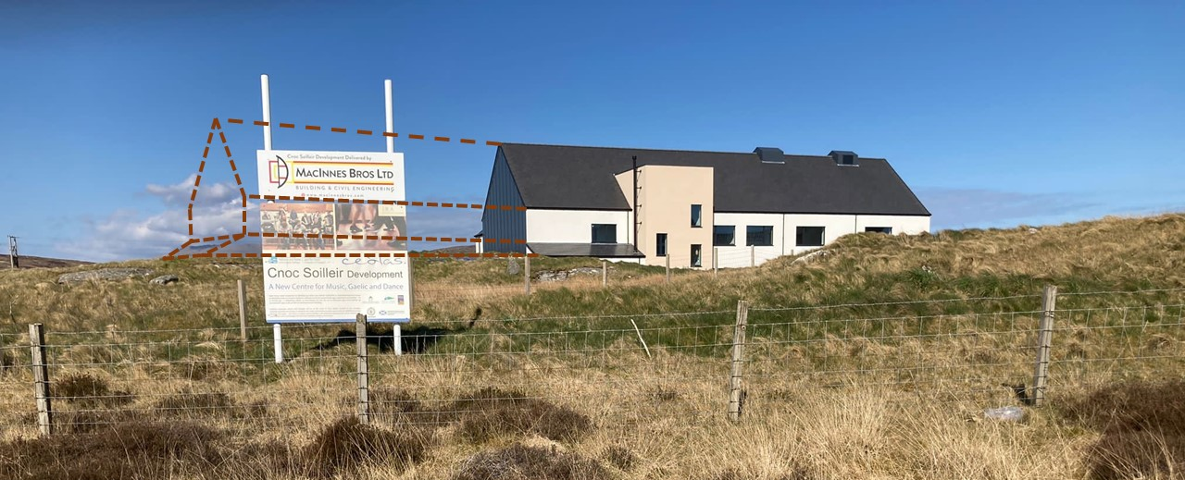
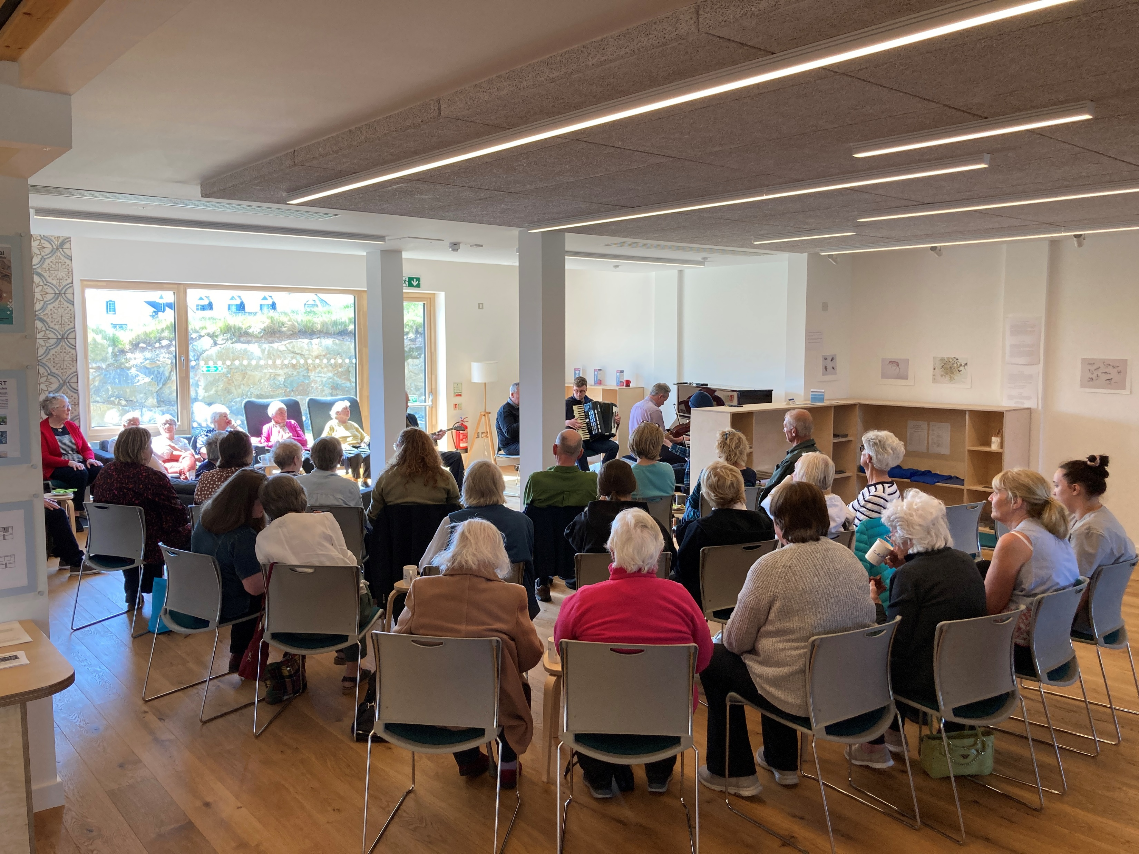
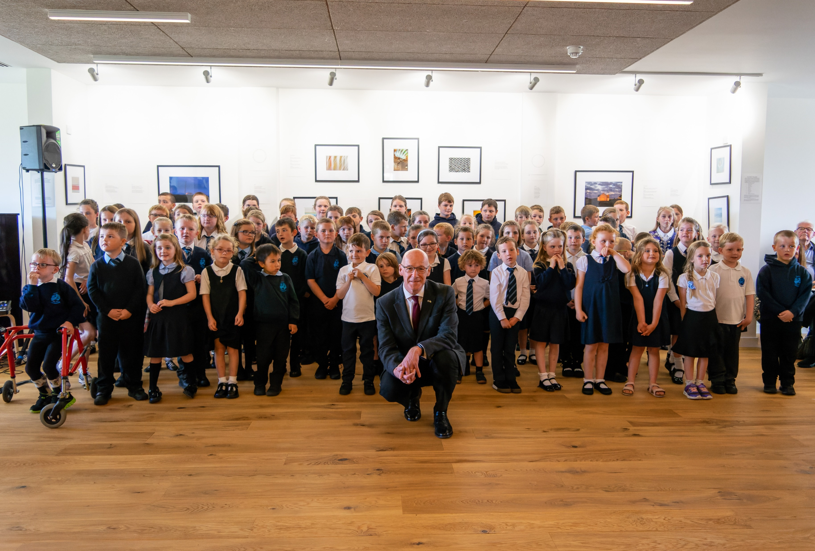
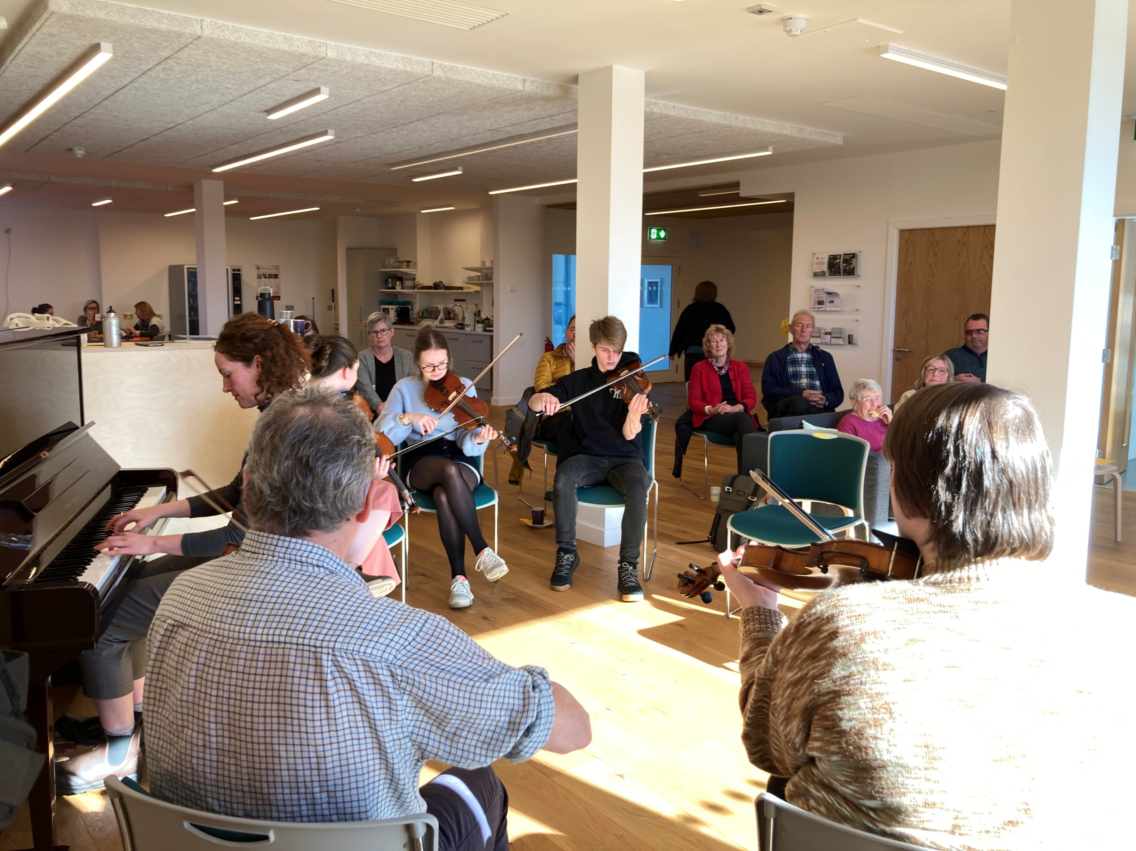
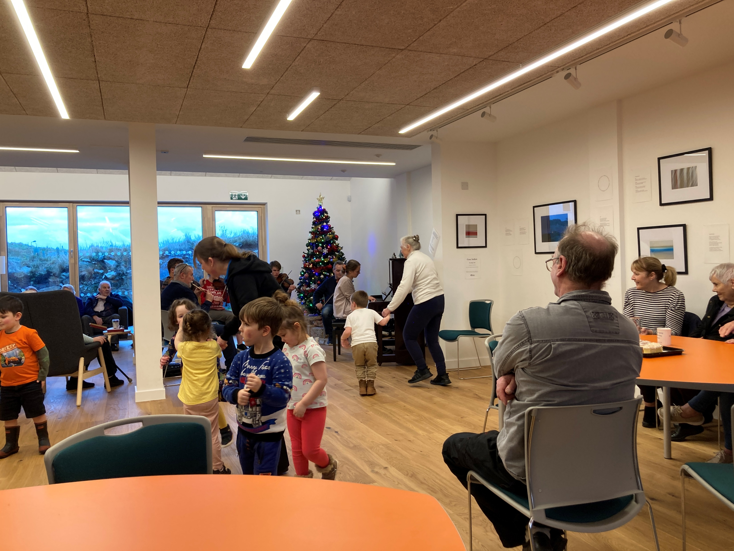
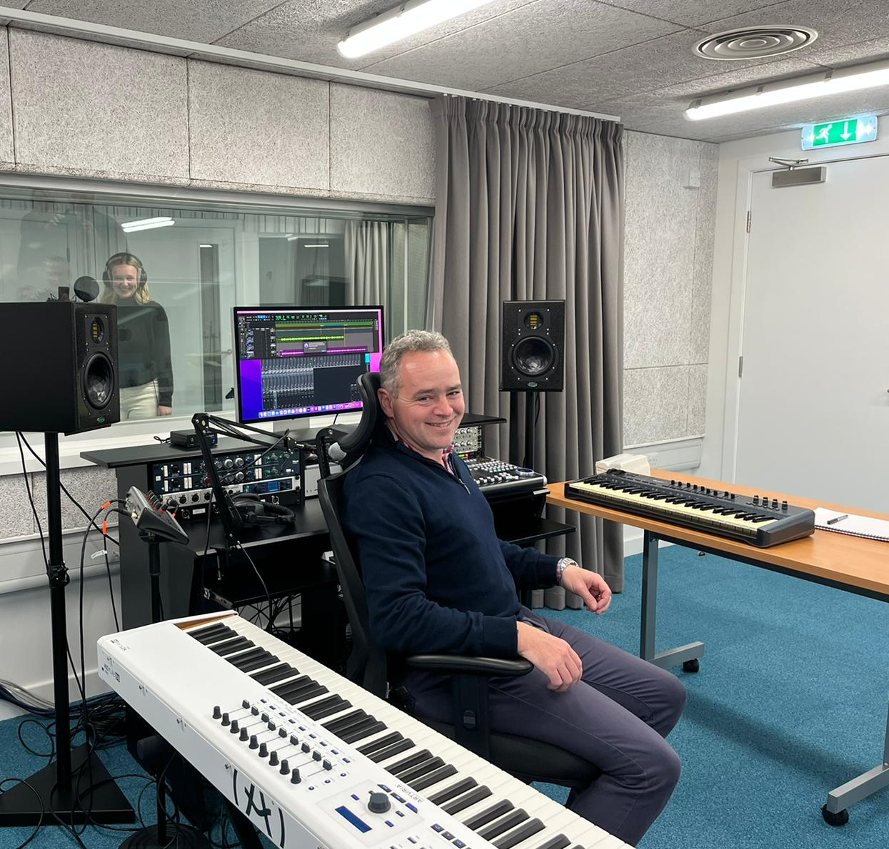
Cnoc Soilleir
Phase 2
Phase 2
Phase 2 Extension to Phase 1 shown dotted
Phase 1 – Our first year of operations
A Joint Venture with a Shared Vision

Slide 13
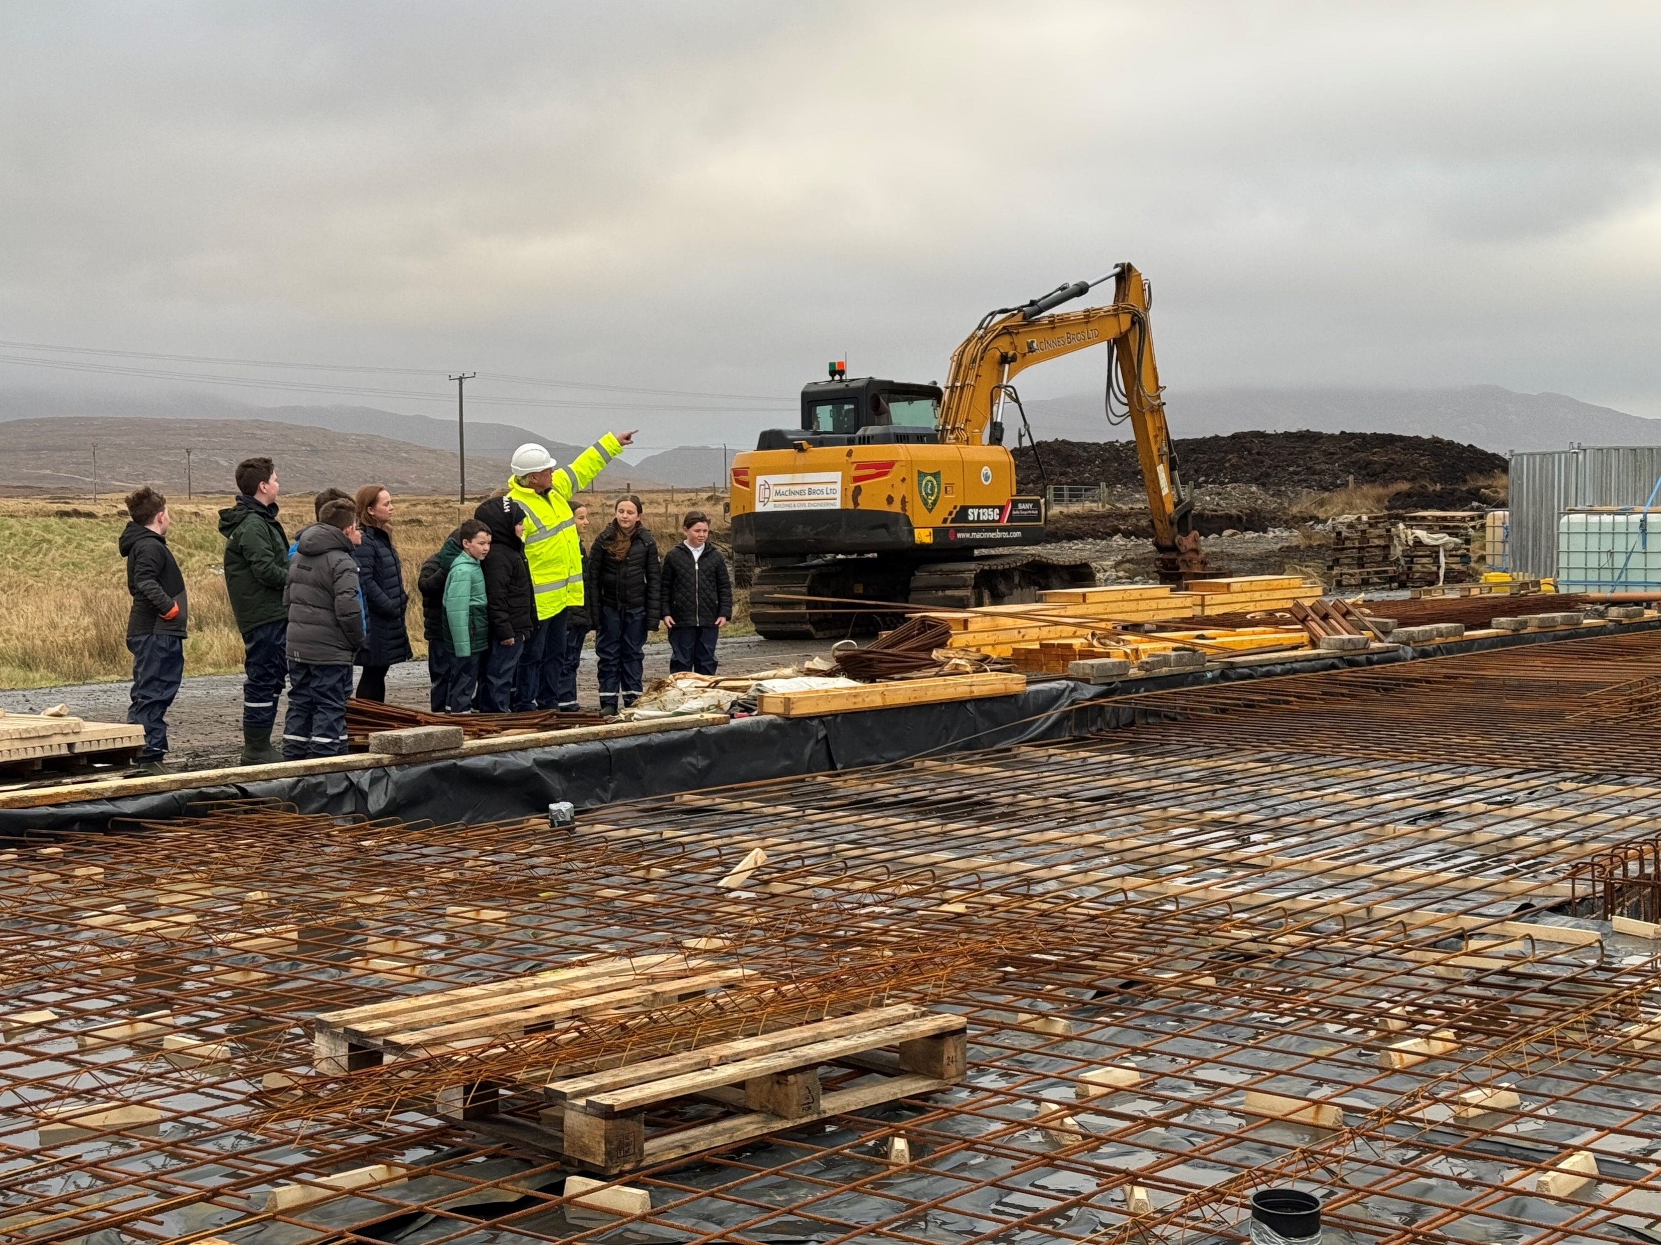
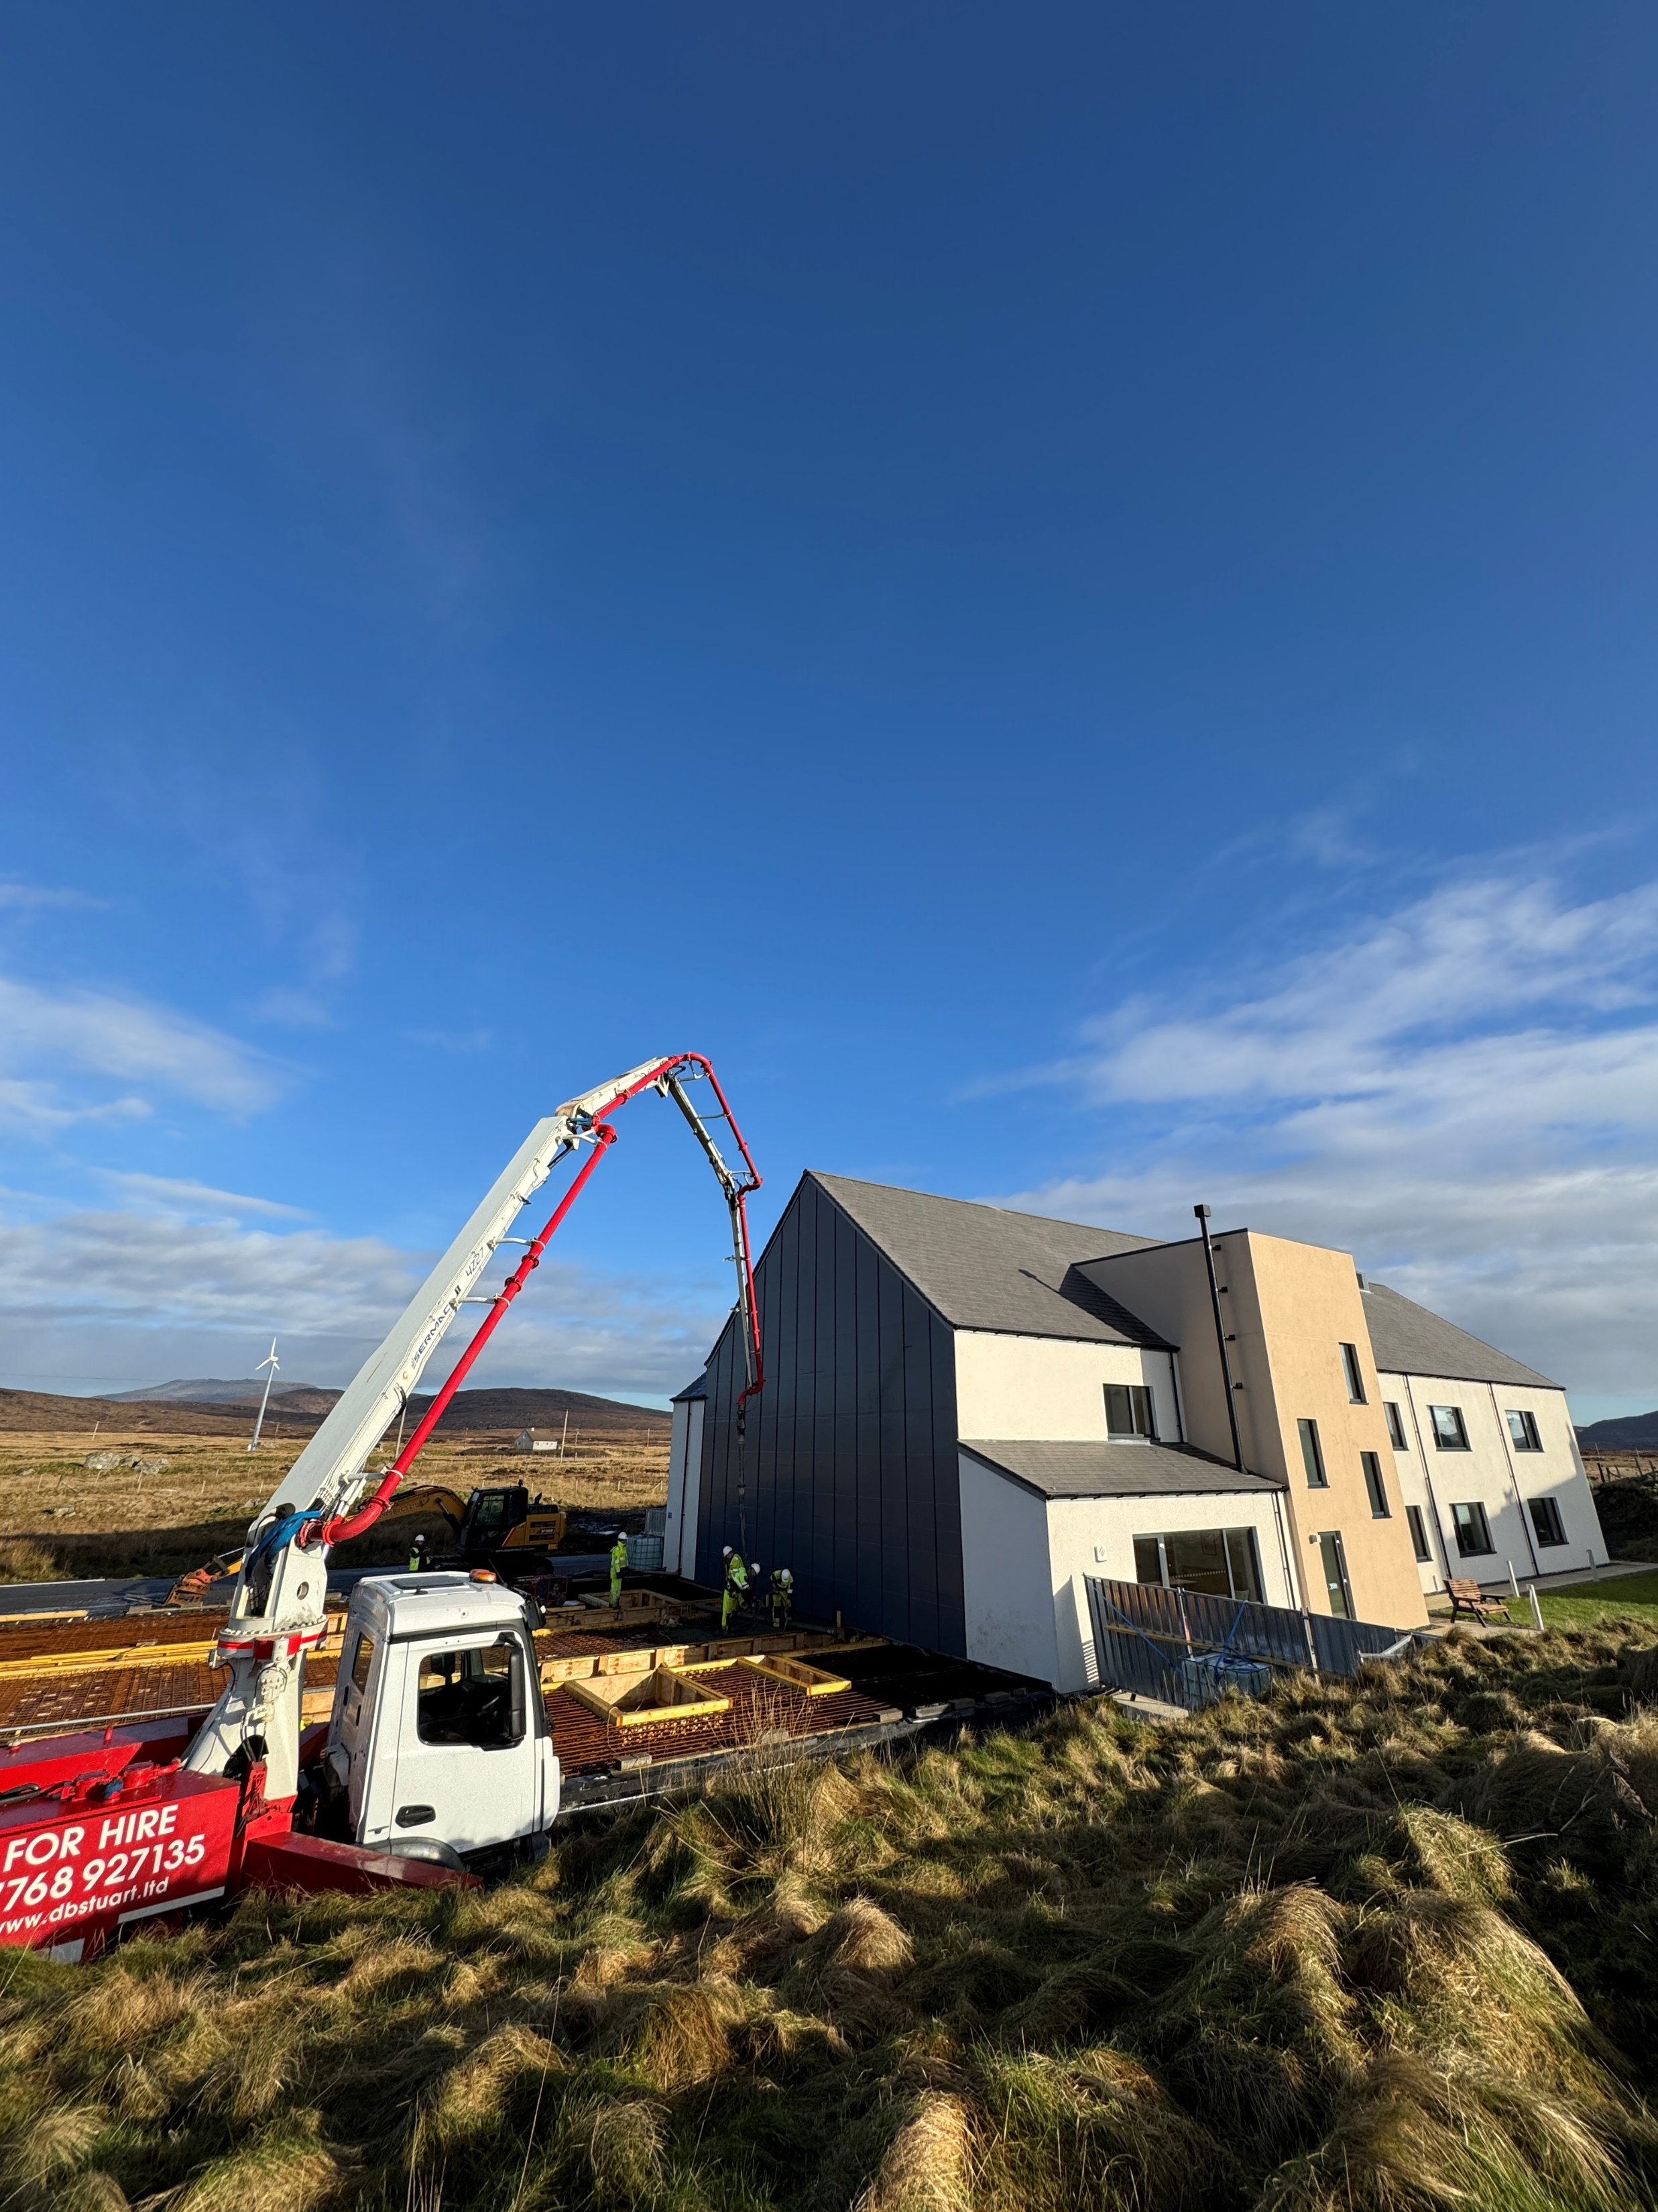
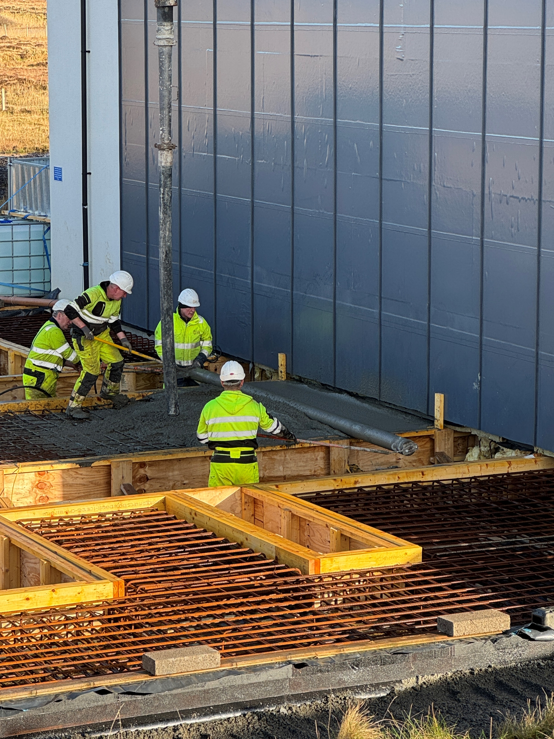
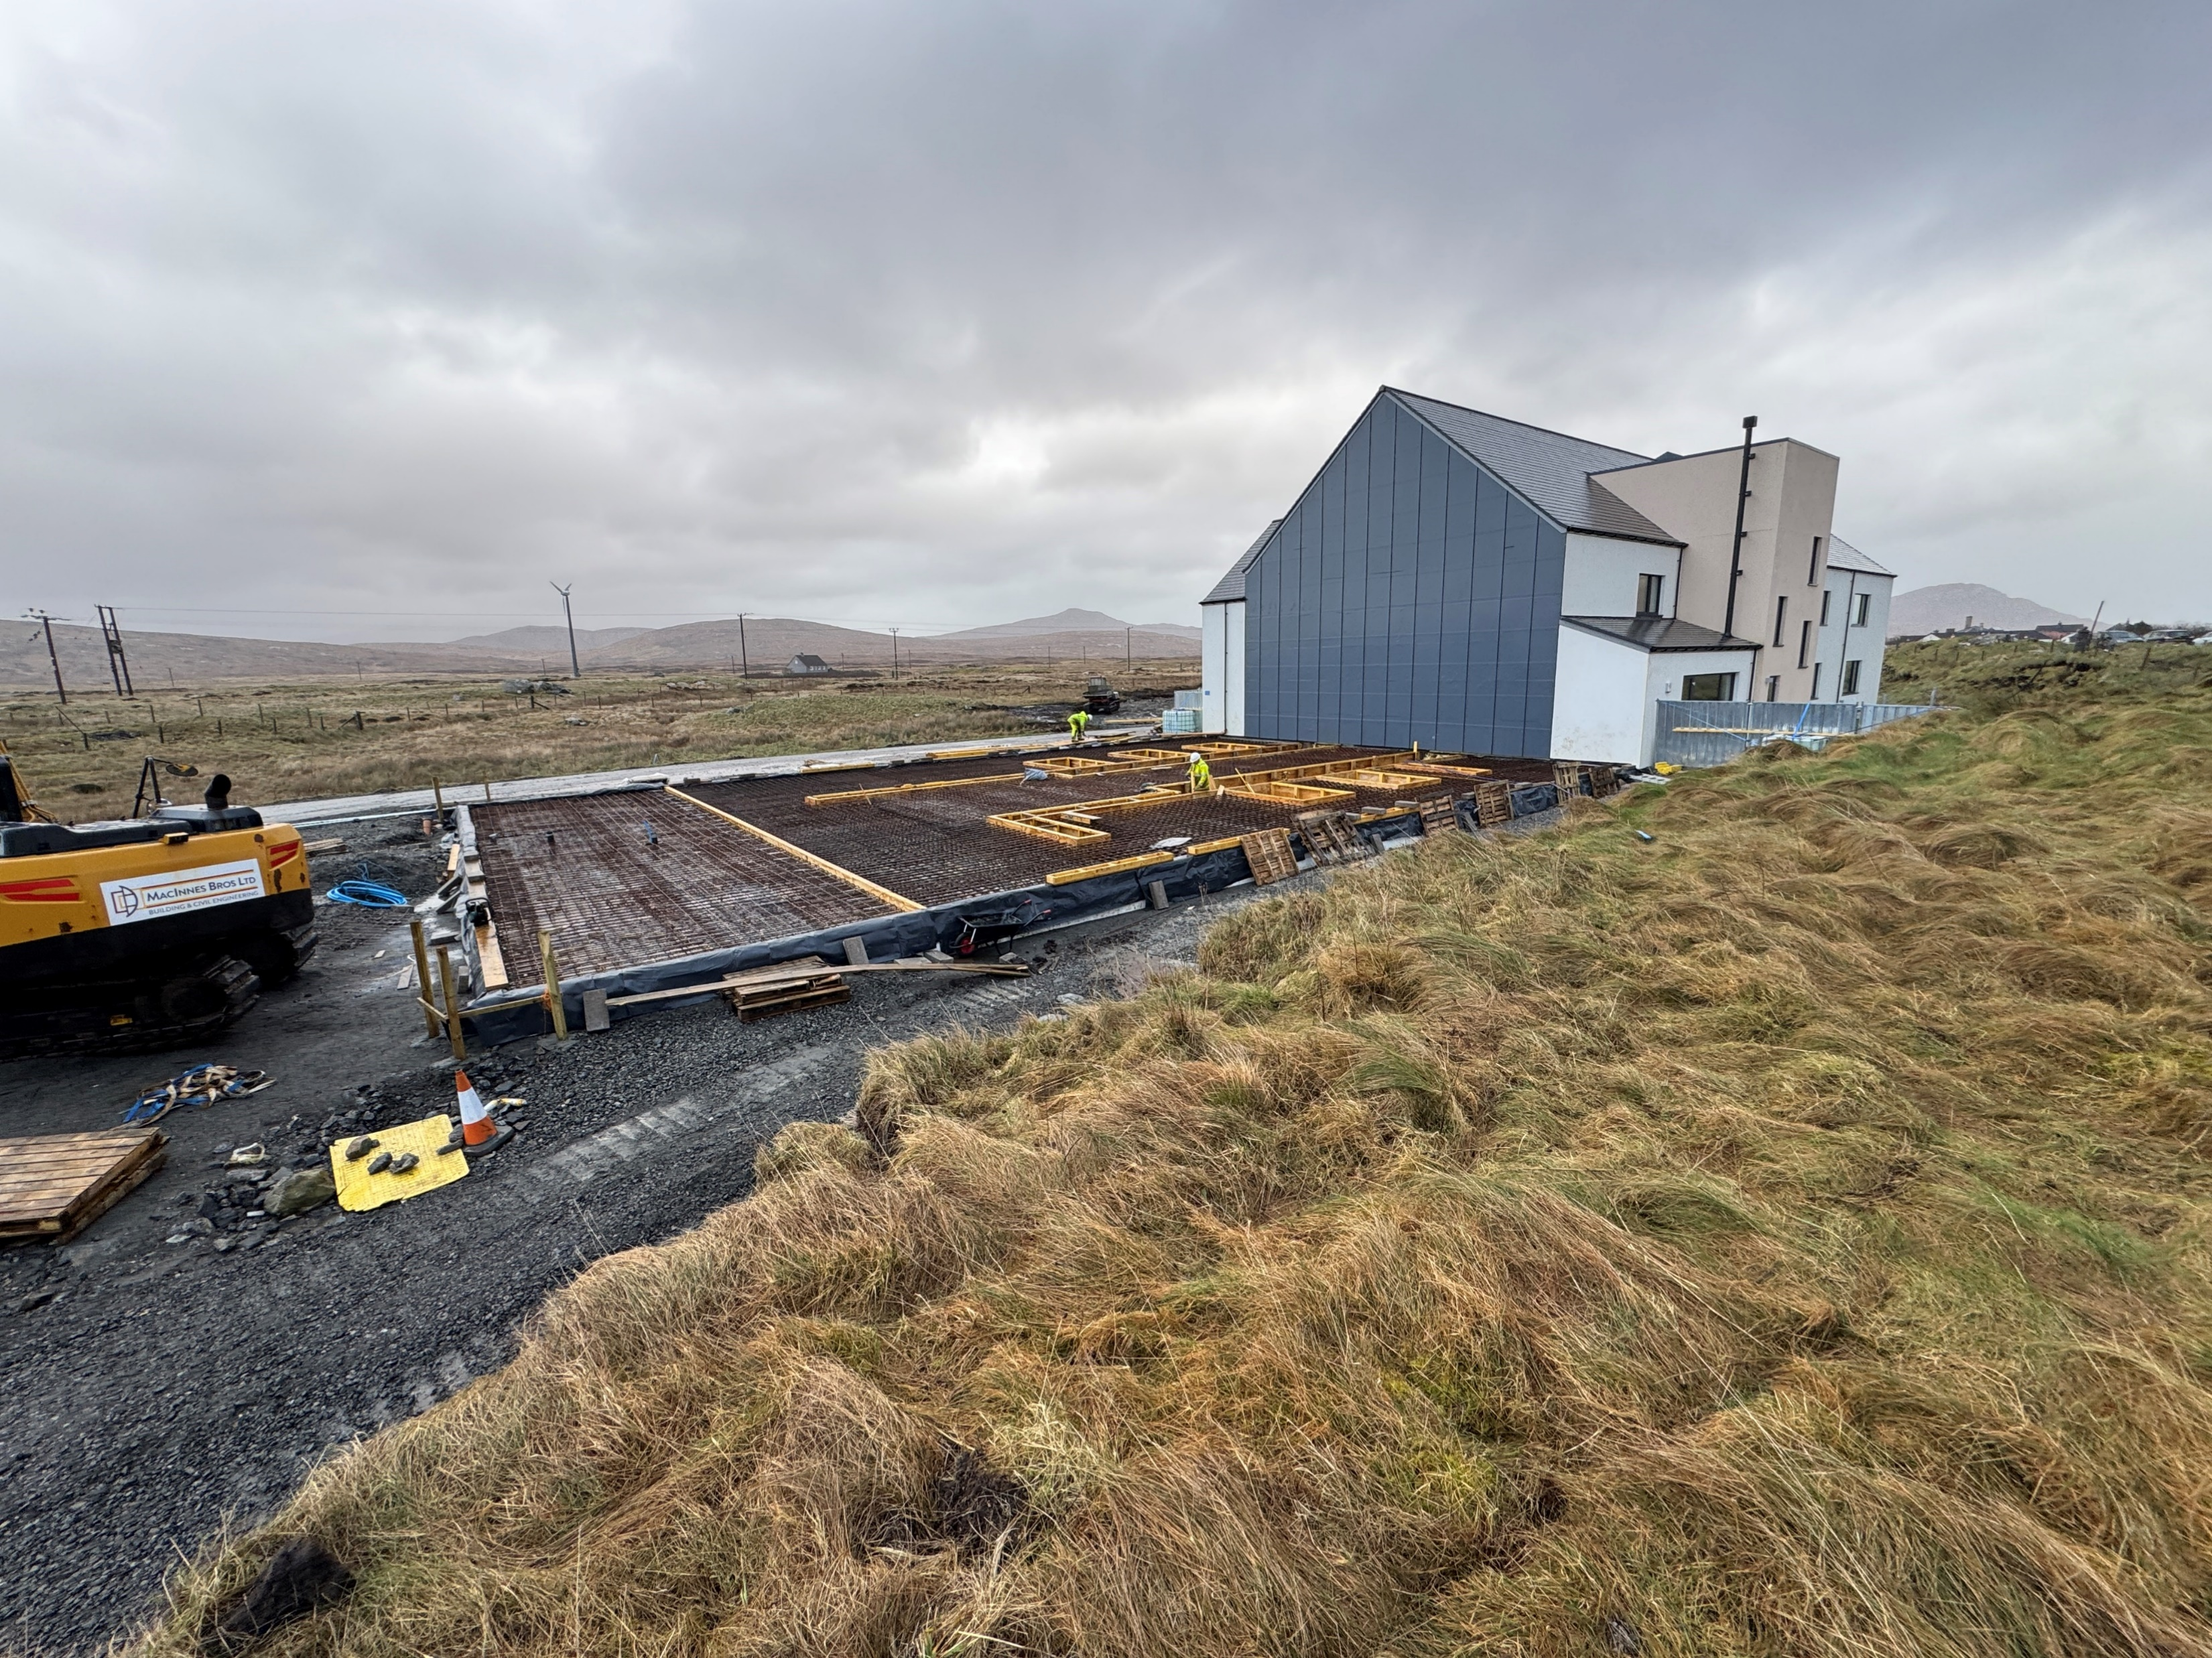
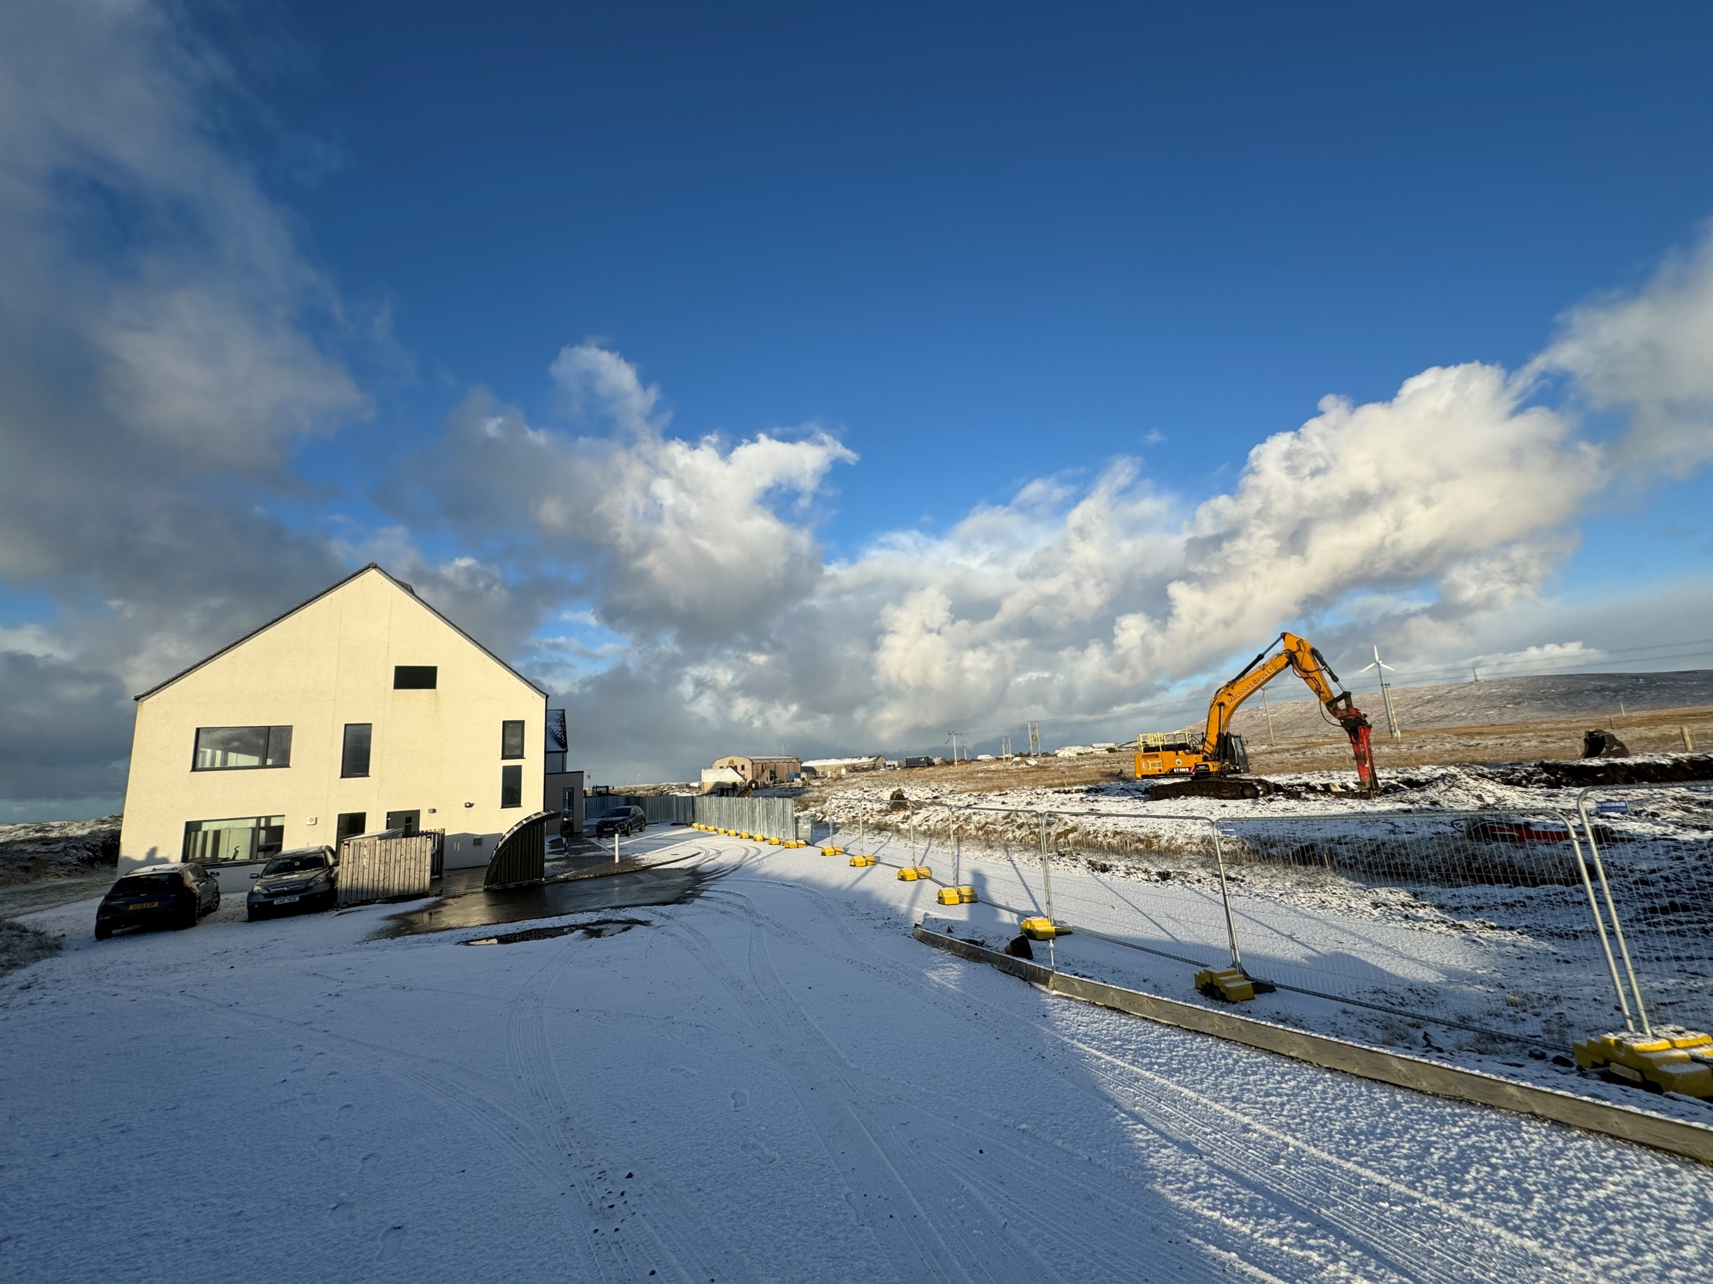
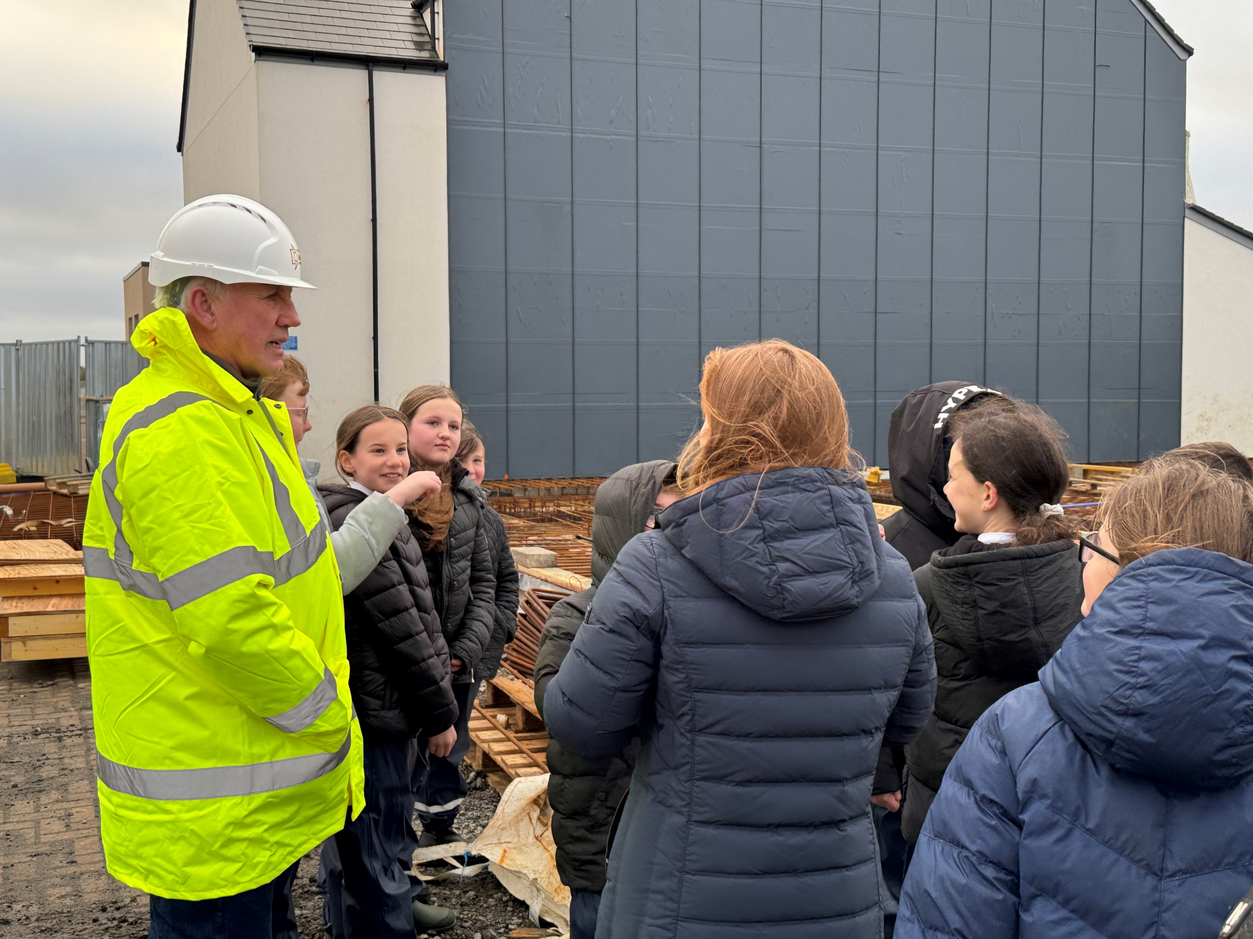
Cnoc Soilleir
Current status of Phase 2 - February 2025
Sept 2024: Full Capital Funding to complete the build for Phase 2 awarded and MacInnes Bros. from Benbecula appointed for the main construction contract with works starting on site in October 2024
A main construction contract of 16 months with a further 2 month post practical completion period for final fit out of furnishings fittings and equipment. We are looking to move in in the spring of 2026.
Phase 1 has been constructed to be extended to include Phase 2 with minimum disruption to existing activities in phase 1.
Phase 2
Aspiration - Inspiration - Transformation
A Joint Venture with a Shared Vision

Slide 14
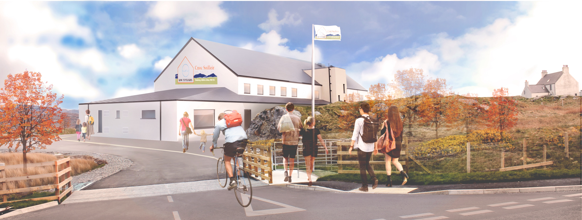
Cnoc Soilleir
Artist’s impression of view from the entrance
A Joint Venture with a Shared Vision

